Slide 1

Team Name : ByteBlaze
Team Leader Name : Varun Vangari
Problem Statement : Build an AI-powered solution that improves access to information, resources, or opportunities for communities and public systems.

Slide 2

Brief about the Idea: BharatAccess AI is a voice-first, local-language AI assistant that helps underserved citizens understand and access government schemes, services, and opportunities without the need for digital literacy, English fluency, or intermediaries.
Instead of asking users to struggle through complex portals, BharatAccess AI is a smart layer of conversation on top of existing public systems. Users can just speak their natural language; the AI checks their eligibility and offers step-by-step advice on the available options, again in simple terms.
Essence of the product:
“From awareness → eligibility → action, in the user’s own voice and language.”

Slide 3
Your solution should be able to explain the following:
How different is it from any of the other existing ideas?
Currently, the government portals lack comprehensive information and tend to be English-dominant, text-based, and user-unfriendly. Helplines involve human intervention and have high waiting times. The CSCs involve physical presence and sometimes involve a fee. Generic AI chatbots simply provide information but cannot personalize the responses provided.
What makes BharatAccess.ai different from the current options is the following five factors:
It is voice-first, not text-first.
It is not limited to English but is offered in local languages too.
It is not just a list of schemes but a personalized eligibility test.
It is not dependent on high bandwidth but can be accessed via WhatsApp or SMS too.
It is not just limited to the delivery of information but goes a step further to deliver actionable steps too.
This makes it a useful and viable product and not just another AI-based chatbot.

Slide 4
How the Solution Solves the Problem
This is because the solution helps to address the root causes of digital exclusion as follows:
Firstly, the solution helps to overcome the problem of language and literacy exclusion by using speech-based interaction.
Secondly, the solution helps to overcome the problem of confusion by making the eligibility criteria personal. This means that instead of having to visit different websites, the user only has to answer a few questions, and the system will then identify the schemes they are eligible for.
Thirdly, the solution helps to overcome the problem of complexity by making the process of applying for the schemes simple and straightforward by using simple and clear language.
Lastly, the solution helps to overcome the problem of middlemen exclusion by empowering the user to have direct access to accurate and simple guidance.

Slide 5
USP (Unique Selling Proposition)
The primary USP of bharataccess.ai is:
A voice-first, local language AI that offers personalized guidance on public benefits even in low bandwidth situations. Supporting differentiators include:
The following are the support USPs:
Hyper-local language support
Eligibility-based filtering
Action-oriented responses
WhatsApp and SMS compatibility
Scalable backend architecture

Slide 6
List of features offered by the solution:
Voice-based interaction using speech-to-text and text-to-speech
Multi-language support (Hindi + one regional language initially)
Smart eligibility engine based on structured scheme rules
Personalized scheme recommendations
Step-by-step application guidance
Document checklist generation
WhatsApp bot integration
SMS fallback for low connectivity
Admin dashboard for monitoring usage and analytics
Knowledge base to prevent AI hallucinations

Slide 7
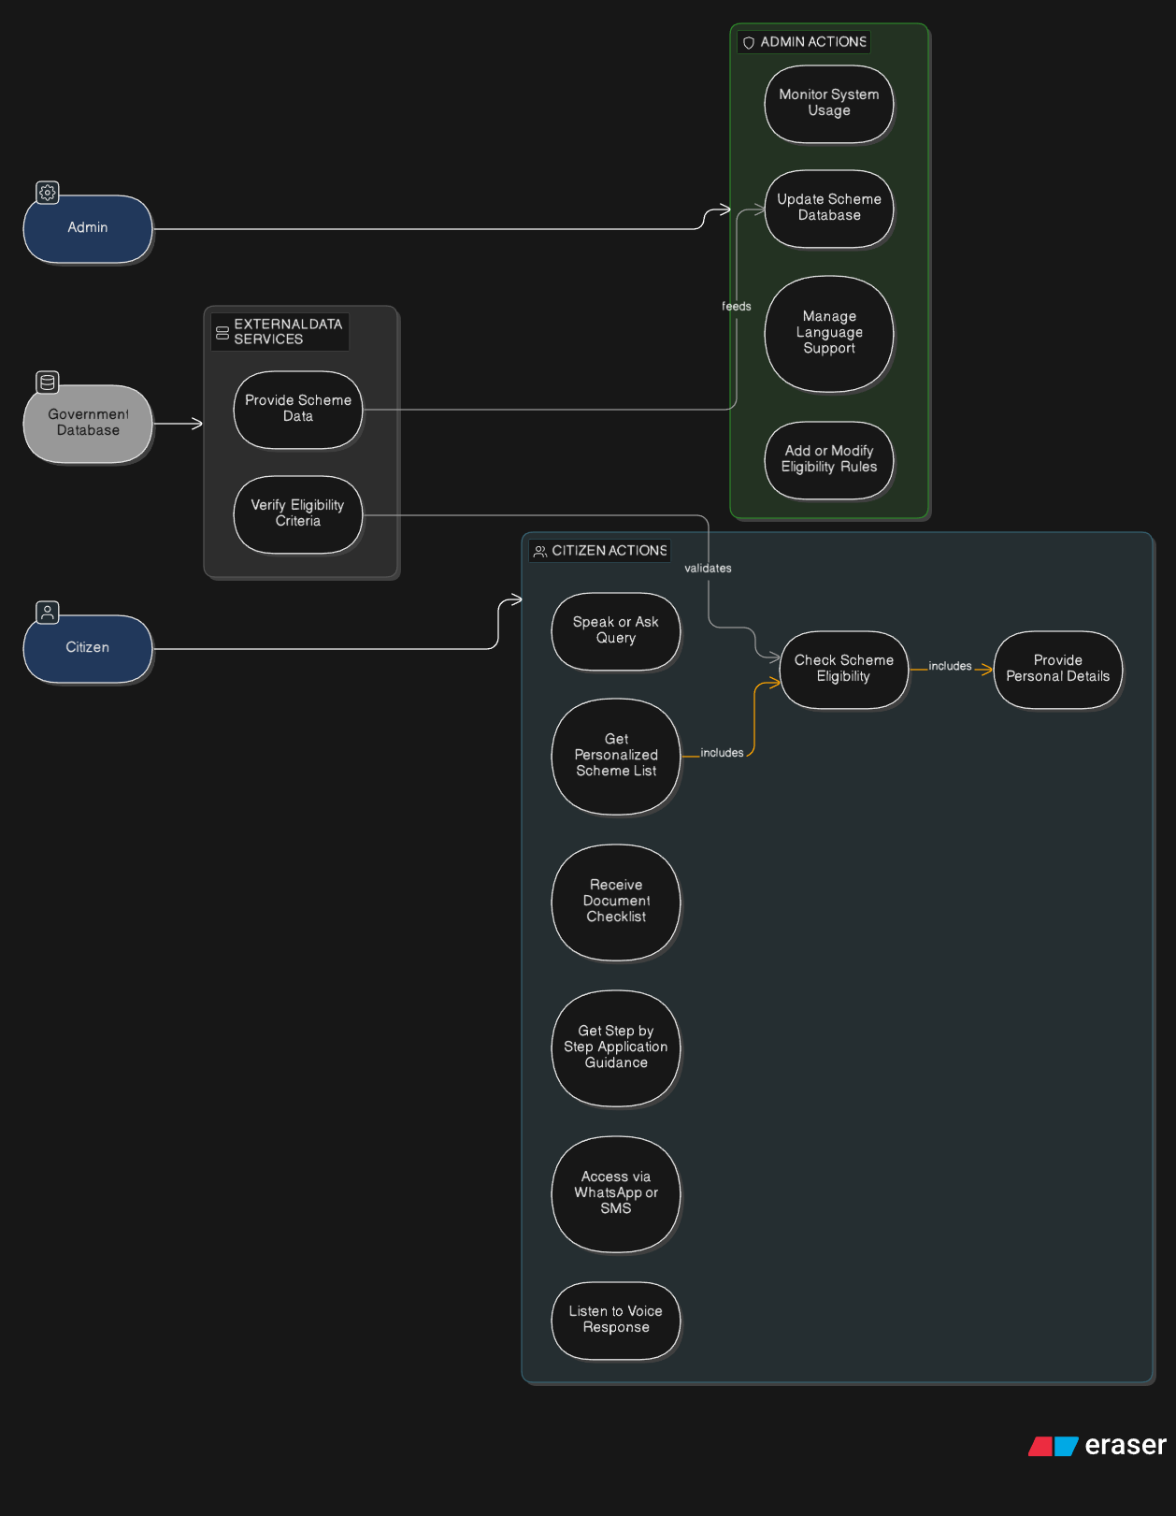
Process flow diagram or Use-case diagram

Slide 8
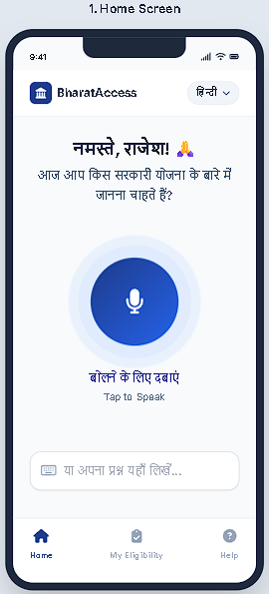
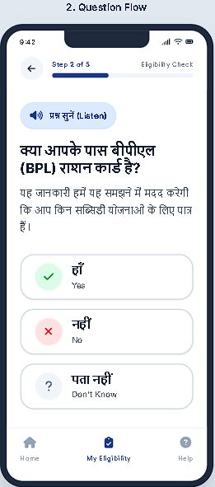
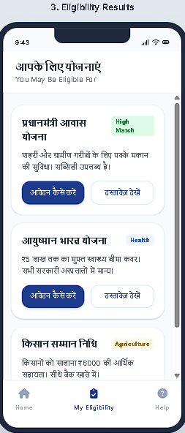
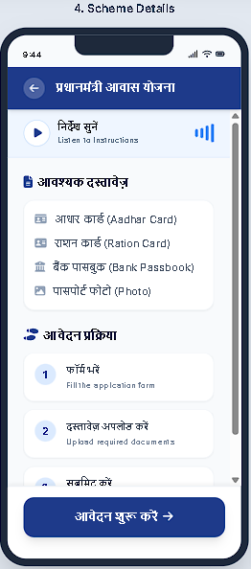
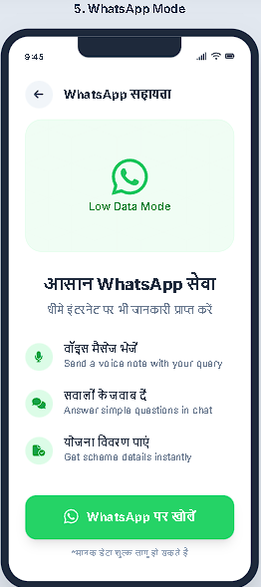
Wireframes/Mock diagrams of the proposed solution (optional)

Slide 9
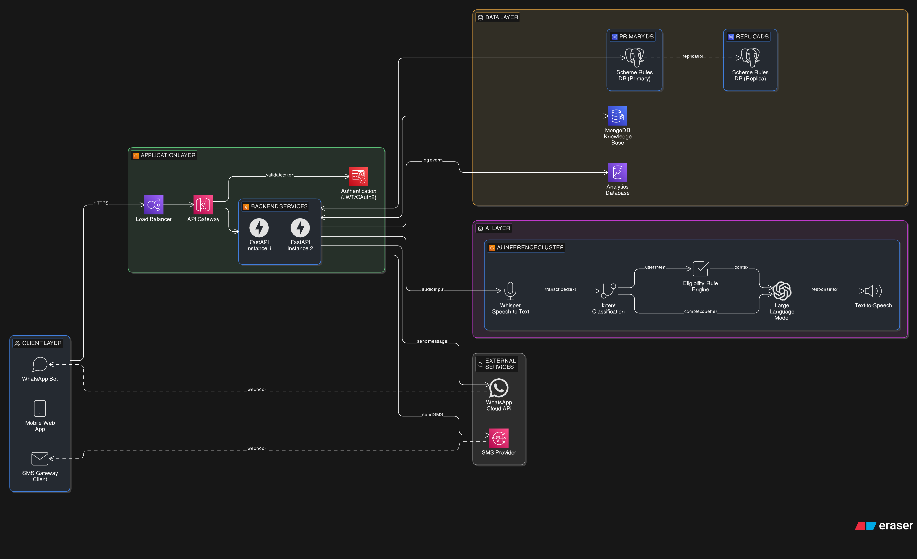
Architecture diagram of the proposed solution:

Slide 10
Technologies to be used in the solution:
Backend
Python 3.10+
FastAPI for REST API
PostgreSQL or MongoDB for database
Redis for caching
AI/ML
OpenAI Whisper (base or small model for speed)
GPT-3.5-turbo /Llama 2/ Gemini 1.5 (Pro / Flash) / Claude 3 (Haiku / Sonnet / Opus) for LLM explanation
Indic TTS (AI4Bharat or Google Cloud TTS with Indic voices)
WhatsApp Integration
Twilio WhatsApp API
Webhook handling with FastAPI
Frontend
ReactJs, TailwindCSS,
Web Audio API for voice recording
Fetch API for backend communication

Slide 11
Estimated implementation cost (optional):
Project (2–3 days) Project (6–12 month)
Component | Estimated Cost
Cloud Server (AWS/GCP) | ₹1,000 – ₹3,000
WhatsApp API (trial) | ₹0 – ₹1,500
Speech-to-Text API | ₹0 – ₹2,000
Text-to-Speech API | ₹0 – ₹2,000
Domain (optional) | ₹500 – ₹1,000
Total Estimated Cost | ₹2,000 – ₹8,000
Component | Annual Cost
Cloud Infrastructure | ₹5–10 lakh
AI Model Hosting | ₹3–8 lakh
WhatsApp/SMS | ₹2–5 lakh
Data & Maintenance | ₹2–4 lakh
Total | ₹12–25 lakh/year

Slide 12
Add as per the requirements for the hackathon:
Problem Alignment
Millions unable to access government schemes due to language & digital barriers
Fragmented portals + complex eligibility processes
High dependency on middlemen in rural India
Direct impact on low-income citizens, farmers, students, elderly
Solves real Bharat-level digital inclusion gap
Innovation / USP
Voice-first public service AI
Regional language conversational support
Personalized eligibility engine (not generic info)
Works on low-bandwidth (WhatsApp/SMS mode)
Serverless, cost-efficient architecture
Scalability & Impact
Designed for pan-India deployment
Multi-language scalable framework
Serverless infra → auto-scale to lakhs of users
Extendable to education, healthcare, jobs, subsidies

Slide 13
Add as per the requirements for the hackathon:
AWS Services Used
Amazon API Gateway – Secure API management
Amazon DynamoDB – Scheme rules & user session storage
Amazon Bedrock / SageMaker – AI model integration
Amazon CloudWatch – Monitoring & analytics
Feasibility & Implementation Plan
Modular microservice-based architecture
MVP buildable in hackathon timeline
Core focus: Voice → Eligibility → Guidance
Easily extensible for future integrations
Social / Business Impact
Reduces middleman dependency
Saves time & application errors
Improves scheme access rate
Promotes digital inclusion in Bharat
Strengthens trust in public systems
Future Scope
More regional languages
Full mobile app
Government API integrations
Predictive eligibility alerts
Public analytics dashboard
Expansion to enterprise civic platforms

Slide 14


